Slide 1
The Vehicle Routing Problem
By Adam Campbell, Tyler Gill, and Tristan Worthington

Slide 2
Introduction
What is the Vehicle Routing Problem (VRP)?
Find the most efficient route between a set of points
Dealing with constraints like capacity and Distance
Contains the Traveling Salesman Problem (TSP) as a special case
Labeled as NP-Hard
Examination of the VRP
Ant Colony Optimization (Nature Inspired)
Clarke-Wright (CW)
Nearest Neighbor Heuristic (NN)
Tabu Search (TS)

Slide 3
Methodology
Programming Implementation - C++
Compiled Language
Control over low-level memory (manipulation of data structures)
Experimentation
Testing Multiple Input sizes (Euclidean Coordinates)
Each algorithm ran for 20 trials per configuration
Compared total route distances to assess accuracy
Averaged runtimes across each trial for each input

Slide 4
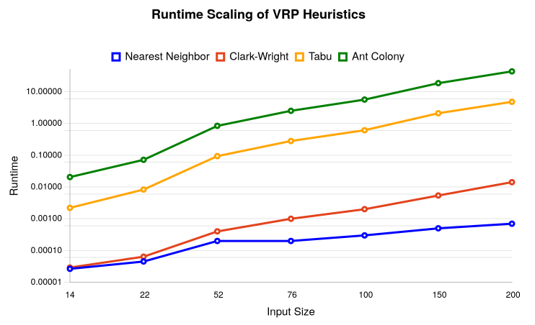
Research Question 1
How does the runtime of each algorithm grow as
input (n) increases?
Results
As input (n) grows, each algorithm grows
Each at different rates
NN exhibits slowesth growth - O(n²)
CW shows moderate growth - O(n²log n)
TS has steeper growth rate - O(k*n)
Ant Colony - Increase in runtime, high computational cost

Slide 5
Research Question II
At what input size does one algorithm outperform another?
Results
No crossover was found
Each algorithm outperformed the next
Suggests stable performance ordering

Slide 6
Research Question II - Drawbacks/Further Look
Key limitations - Limited range of input sizes & comparison to optimal solution
Crossover point missed
Further experimentation - large scale instances and best-known solution
Input size at which higher cost algorithms begin to justify runtime when compared to solution quality
Ultimately, order of scalability remains same across each input size

Slide 7
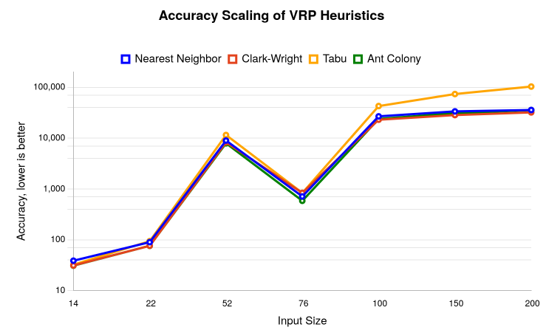
Research Question III
How does runtime compare to solution accuracy?
Unexpected Results
3/4 algorithms perform nearly the same in terms of solution accuracy - slight deviations
Tabu Search breaks trend at n = 100
Failed to outperform simple heuristics - counterproductive at scale

Slide 8
Research Question III - Drawbacks/Further Look
Key limitations - Limited range of input sizes & comparison to optimal solution
No true measurement made - only relative measurements
Further experimentation - large scale instances, best-known solution, more trials

Slide 9
Conclusion
Purpose
Evaluate runtime scalability
Find solution accuracy of heuristic/metaheuristic approaches
Results
Consistent tradeoff between efficiency and accuracy - NN & CW scale well, maintain low runtime
TS and Ant Colony achieve higher quality at a significant computational cost
No crossover observed - Limited by scope of input size, parameters, no optimal solution comparison
Lesson learned - select an algorithm based on practical constraints (solution quality is primary concern)

Slide 10
REFERENCES + AI STATEMENT
https://github.com/mastqe/tsplib
[1] Reinelt, G. "TSPLIB--A Traveling Salesman Problem Library." ORSA Journal on Computing, Vol. 3, No. 4, pp. 376-384. Fall 1991.
Generative AI was used in the creation of the following:
Clarification of Time complexities for algorithms and clarification of the Vehicle Routing Problem for Checkpoint #1
Design and Debugging of clarkWright.cpp and antColony.cpp
Grammar check and clarity check when compared against final deliverables for 2400 Project Report

Slide 11
Questions?

